Slide 1

VATES
Toby Perring
Owen Arnold, Michael Reuter, Janek Zikovsky, Alex Buts, Martyn Gigg, Nick Draper

Slide 2
VATES
Visualisation &
Analysis
Toolkit
ExtensionS
Notes:
VATES stands for Visualisation and Analysis Toolkit extenstions. And those extensions are to the original Mantid Project.

Slide 3
VATES
Visualisation of multi-dimensional data
Single crystal spectroscopy: Qx, Qy, Qz, ω
- 10⁹ - 10¹⁰ detector element – energy pixels
- pioneered at ISIS; now in routine use at ISIS, SNS, ILL
Diffraction: Qx, Qy, Qz + temp, field, etc
- Can collect an order of magnitude or more faster.
General requirement of all instruments
Fitting of (resolution broadened) parameterised models to data
Single crystal spectroscopy the inspiration
Generic problem for all instruments
Notes:
VATES stands for Visualisation and Analysis Toolkit extensions. And those extensions are to the original Mantid Project.

Slide 4
Project Goals
Provide tools for generic visual data reduction
Terascale Visualisation
Move seamlessly from large to small scale
On-the-fly rebinning of sparse data
Application to fit/simulation resolution broadened models
Arbitrarily large or small collection of cuts
‘Menu’ of resolution function convolution models
User-supplied models
Seamless working environment
Consolidation and extension of existing tools
TobyFit, Horace knowledge
Build upon and extend Mantid

Slide 5
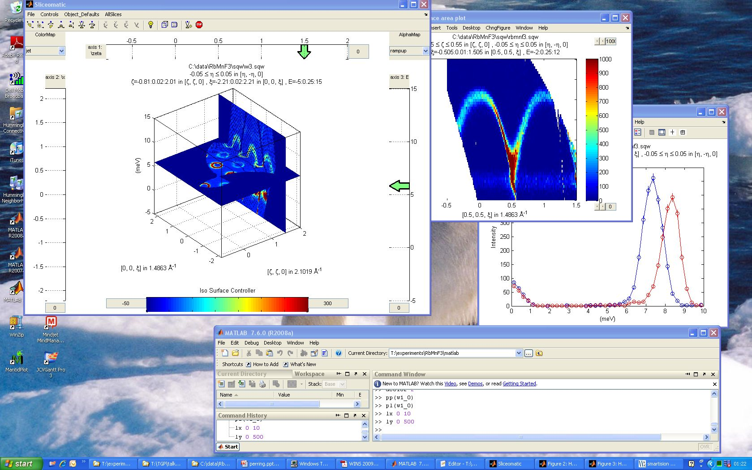
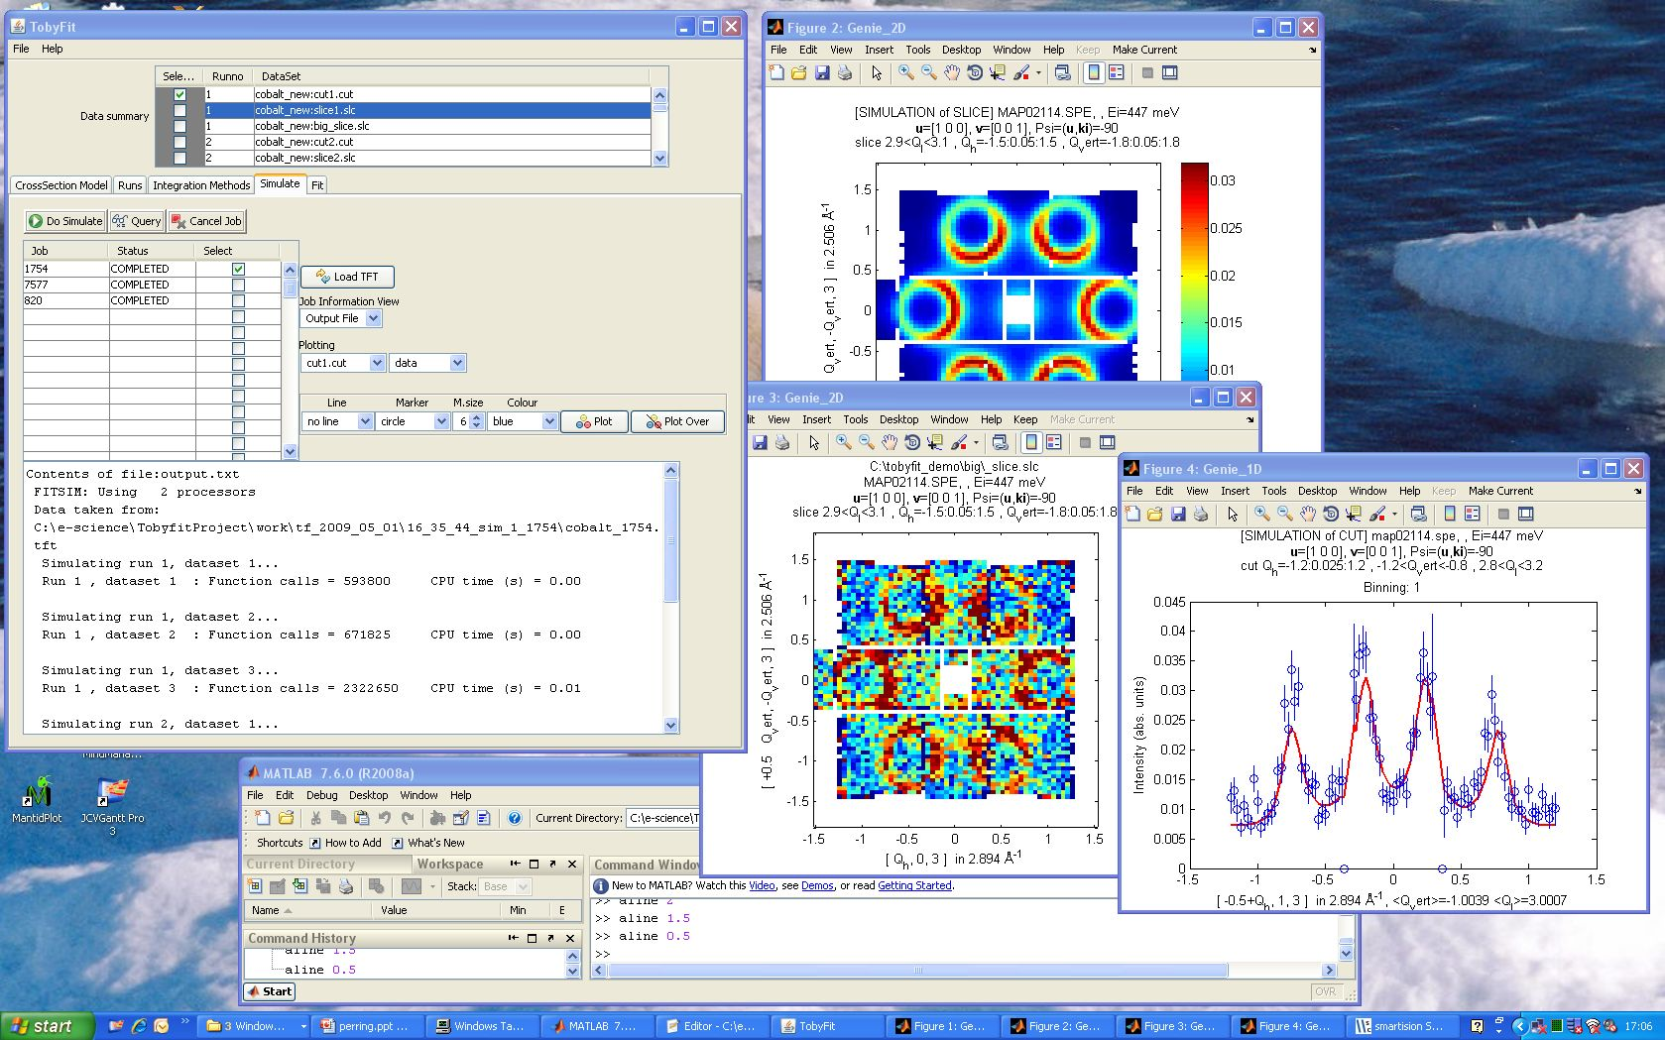
Horace
Horace, Tobyfit very successful
BUT
Specific (inelastic only)
Matlab based
Very small group of developers
Developed in isolation
Cannot easily extend
Tobyfit

Slide 6
Design Choice: Mantid
Mantid: Instrument and technique independent Data Reduction and Analysis.
Adopted by ISIS and SNS (joint project, ~15FTE)
85% of instruments at ISIS
Overlap in end-goals
Overlap in common functionality
Mantid
VATES
Notes:
An early design choice was to build VATES on-top of the core Mantid framework. This has turned out to be a great choice. This was originally done so that VATES could share the core functionality of Mantid, without having to re-invent the wheel. This projection did materialise, and we were able to spend much more of our time generating new and exciting features as a result. What’s increasingly been happening now is that Mantid has been benefitting from functionality generated for VATES. The overlap is actually much larger than we expected and the benefits go both ways.

Slide 7
Project Plan
Year 1
Year 2
Requirements Engineering
Prototyping
Global Design
1st Iteration
Nth iteration
Final Deployment
Maintenance
October 2010
September 2012
Notes:
Two years ago at the last Nobugs conference, we showed a timeline of our progress. The last Eight Mantid releases have included incrementally improving versions of the VATES toolkit. On the original diagram, we included final deployment and maintenance phases. We haven’t reached those milestones for two reasons. Firstly the VATES project has now been fully absorbed into Mantid, so it’s becoming harder to distinguish between effort going specifically into Mantid and effort going specifically into VATES. Secondly, our users provide us with a seemingly in-exhaustable list of requirements.

Slide 8
Actual Project Progress
Prototypes
Dynamic rebinning
Binary MD algorithms
Visualisation driven on the fly rebinning
VATES and Mantid packaged together
Quantification and simulation
nD Data formats
VATES as plugin installer
VATES
nD Visualisation
Unified ConvertToMD
Simple Vates GUI
Slice Viewer
Paraview-Mantid Plugins
SX MD Algorithms
Mantid
Notes:
This is another view of the project, where we illustrate how protoypes have been folded into VATES, which has in-turn been folded into Mantid. We’ve highlighted a number of important milestones along the way.

Slide 9
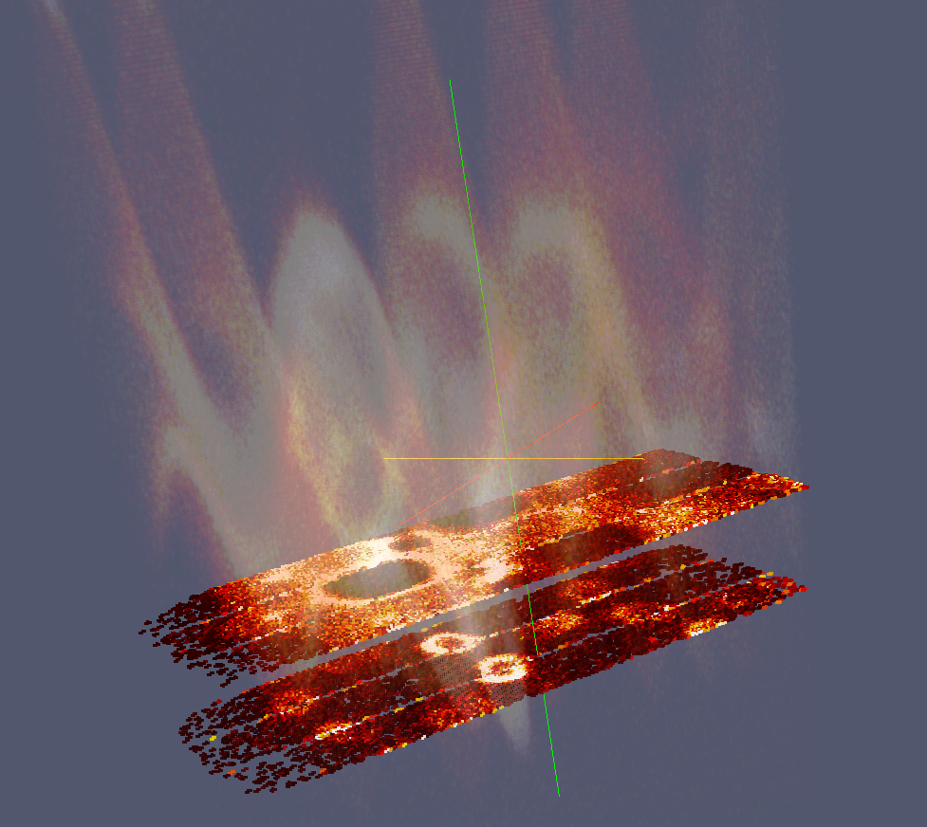
3D Visualisation : Rebinning
Drive analysis by visualisation
Dealing with massive data volumes interactively
Continue processing data
Notes:
There are a number of stories through the VATES evolution. As we are limited on time, I choose to focus on how the Visualisation tools have developed.
The holy-grail if you like, of Neutron Data Analysis for some time has been to drive on-the-fly binning from a visualisation layer. Datasets are sparse, and scientists don’t always know where to look for the regions of interest, moreover, many features do not become apparent or statistically significant until they are binned.
In order to handle large data volumes, it’s common to look towards a distributed computing solution. However, there are three areas of insight that allow us to collapse massive data volumes into something much more manageable. Firstly, the data is not useful in it’s raw state, so we can bin the data to a coarse grid and build our visualisation off the accumulate properties in the grid rather than the raw observations. Secondly, once the data is rebinned, it is often still very sparse, so our default behaviour is not to visualise the zero counts. The third trick, is to decouple the visualisation and display layer completely from the algorithmic layers. The binding layer works out whether a user requested operation constitutes a rebin, or whether shortcuts can be made to redraw the exiting data representation.
We consider our project to be unique amongst many of the other visualisation projects conducted at RAL because the visualisation is not a gimmick! Quite often visualisation is seen as the icing on the cake, something to impress dignitaries and potential sponsors. Once our users have performed the visualisation, they will quite frequently continue processing the output data.

Slide 10
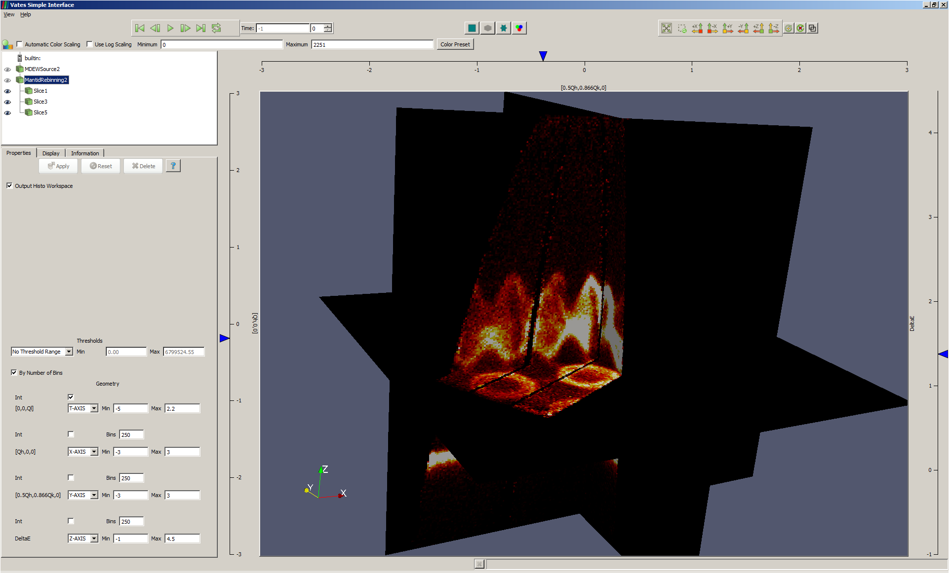
3D Visualisation
Notes:
Our first implementations of the visual rebinning, were plugins to a 3rd party visualisation framework called ParaView. We quickly discovered, that most users, did not need the full power of the ParaView framework, and that some common operations, such as slicing projections through the data, required too many mouse clicks and took too long.
So we prototyped building a stripped down GUI, using the native ParaView framework as a back-end. This worked quite well, so we ended up integrating it with our MantidPlot application. The simple GUI supports multiple view, this one allows users to generate n-orthognal slices. All they need to do is click on one of the outer axis, which generates one of these blue markers, they can then slide it up and down, and it will move and render the associated projection in real time.
“multislice view”

Slide 11
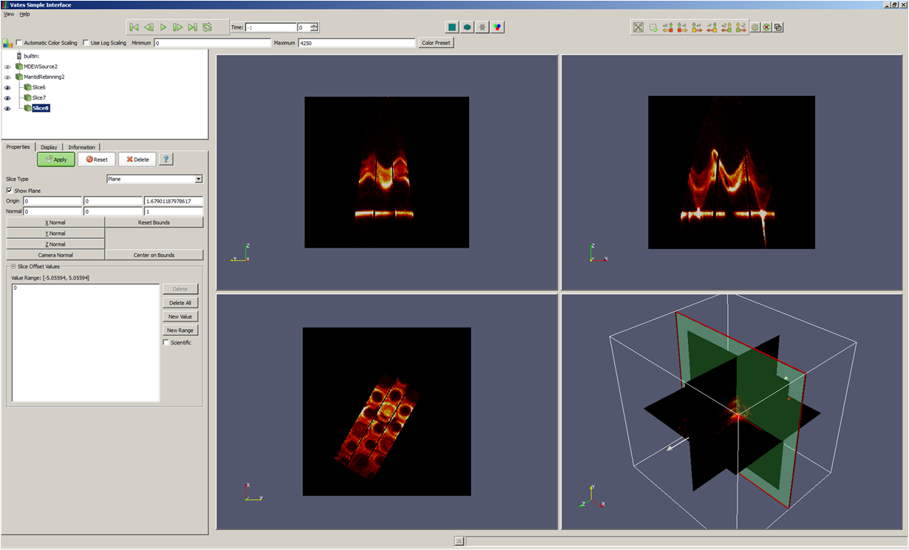
3D Visualisation
Notes:
Another view mode is the three slice mode, here users get a fixed number of projections, each in its own nested sub-window. From the 3D one on the bottom right, they can move the position of the slices, which will cause the corresponding projection to update. ”3-slice view”

Slide 12
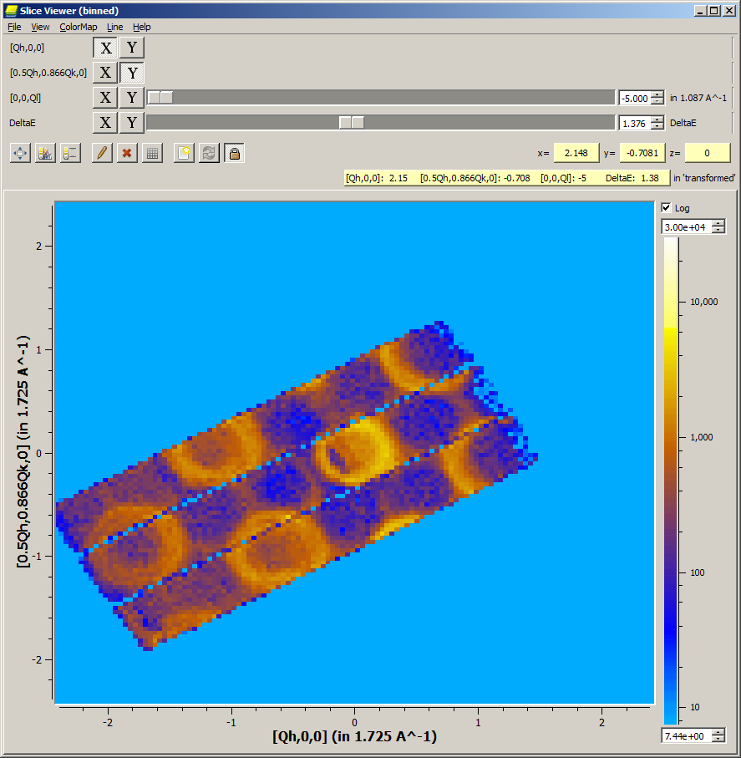
3D Visualisation : Make it even easier
Notes:
We received requests from some users who, wanted to trade-off some of the niceties of the 3D visualisation for raw speed. For these purposes, we built the slice viewer, which will generate a 2D projection through an n dimensional data set. You can choose which dimensions you want plotted against X and Y. Sliders can be used to control the positions in other dimensions.
“sliceviewer”
RC in Mantplot to get option
Dynamical rebin

Slide 13
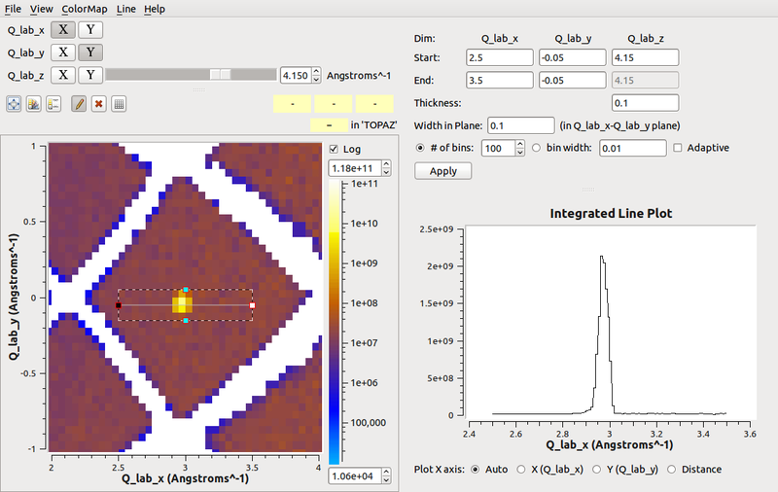
3D Visualisation : Make it even easier
Notes:
One day I was working with on an issue with one of our users on an unrelated issue. At the end of the conversation, he started listing out requirements for what has become one of our killer features, the line viewer. This allows users to use the slice viewer to generate a line with a width and thickness and arbitrary start and end points. When they hit apply, we generate an new dataset, which contains the data integrated along this line. You can see an interactive preview plot for the output above.
Line workspace stored as workspace – then shut down viewer and carry on with your work

Slide 14
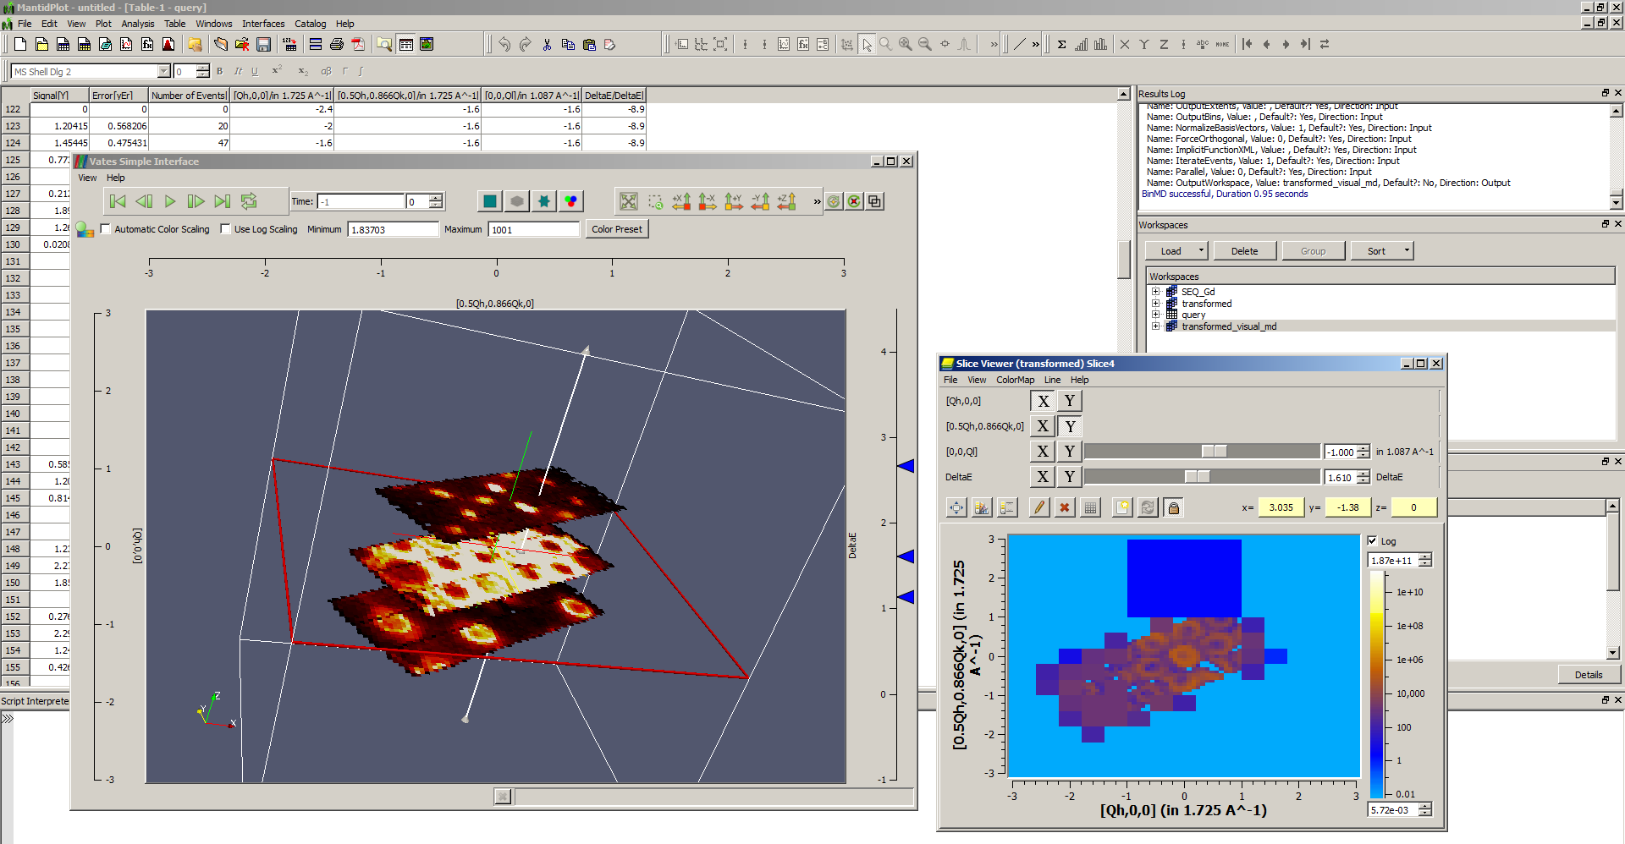
nD Visualisation : Make it cohesive
Notes:
I said that one of our requirements as to bring everything under one roof, here’s a demonstration of things working together.
After performing some work, users can right click their workspace in MantidPlot to bring up the vates simple interface. In this example, I’ve taken an input workspace and visually rebinned it. I’ve generated a number of slices in the 3D visualisation as I’ve been doing this. I’ve then decided that I liked one of the slices, right-clicked on it and exported it to the slice viewer, where I might have performed a further rebin or integration. Fundamentally the outputs of all my operations appear in the workspace list, so I can close down my visualisation windows, and move my data through to the next phase in the analysis.
It’s also worth mentioning that most of the above process can be controlled via our python scripting interface.

Slide 15
Things that have worked well
Close collaboration with the users as a priority
Drawing requirements from more than one facility
Leaning on, and adding to an existing framework
Decoupling the visualisation from the algorithmic/execution layer
Continuous integration with regular releases
Solving deployment in first steps
Notes:
By far the greatest and most important contribution to this project has been our collaborating scientists, who have made this project a success and prevented it from becoming a colossal waste of money. I cannot emphasise how vital this level of input is, and therefore how important it is as a development team to ensure that that information is acted upon quickly.
We have been fortunate enough to have a flow of requirements from two independent facilites. This has made it easier to provide many correct, widely applicable implementation, rather than ad-hoc features that fit for one group and one facility.
Starting from scratch is often a ruinous mistake. Building VATES on-top of Mantid meant that the team was almost immediately productive in creating new features.
Decoupling the visualisation layer from the algorithmic, execution layer has had too major advantages. Firstly, it made it possible to switch visualisation vendor with a few days worth of effort rather than a few months. Secondly it made it possible to test and develop the logic of the visualisation-driving layer using standard unit-testing techniques.
Linking on somewhat from the previous point. The VATES tools are incorporated into our continuous integration set-up. This helps ensure that the tools can always be built on our target platforms, that it is functionally doing the right thing, and that it can always be packaged on each of those plaforms. Regular releases have been critical in allowing our users to try the tools out and provide feeback.
In order to take advantage of the previous, it was vital that the VATES tools were moved from development-prototype into something that could be installed and executed by our users easily. We therefore pushed solving deployment to the top of our to do list.

Slide 16
Things we could have done better
Close collaboration with the users as a priority
Building the SliceViewer before the 3D Visualisation
Better test coverage across the board
Notes:
No room for complacency here. There have been occasions where new features did not meet the users expectations. More often than not, these issues could have been stamped-out much earlier. For example, we did not appreciate how intuitive the 3D visualisation tools would need to be during our first iteration.
We should have envisioned the simplest visualisation usage scenario before the more complex one.
Users rightly get annoyed, when things suddenly stop working as they should. Although we like to think such scenarios are rare, when they do occur, they usually could have been avoided outright if we had proper automated test coverage for that functionality.

Slide 17
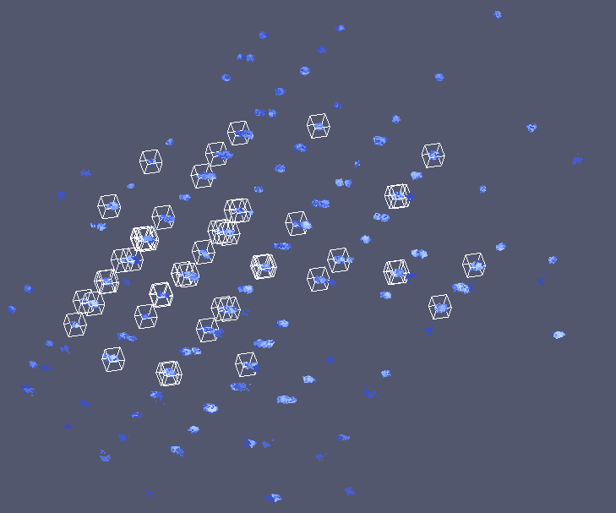
Looking Forwards
Many different scientific group workflows still being polished
Integration with simulation and Fitting
Notes:
Dump output of peak finding onto workspace, then move around in 3D to see how well its done.
Input from all directions whole other stories:
Dennis M. and peak searching
Horace
:
Hot off the presss: Md workspaces can be exported as numpy arrays (and v.v.)

Slide 18
Model Fitting – initial report
Visualisation ⬅➔ model fitting/simulation
Highly iterative procedure
Require seamless integration with Mantid and visualisation
Allow user-supplied models for scattering
‘foreground’: typically global across dataset + resolution
‘background’: simple (e.g. Linear background), no resolution
Fits in with existing Mantid Fit framework
Resolution/Foreground/Background models follow existing “plug-and-play” pattern:
Fit/Simulate works on common interface
Allows any number of resolution, foreground & background models to be defined

Slide 19
Components
The main Mantid fit function
Background model
uses current Fit mechanism
ResolutionConvolvedCrossSection
MDResolutionConvolution
ForegroundModel
TobyFitResolutionModel
OtherResolution1
Model1
Model2

Slide 20
Foreground Models
Commonly added to/changed
Common interface allows models to be written in:
C++
Math string
Python (performance could be a problem)
Fortran (may not be necessary with well-defined C++ template)

Slide 21
Model fitting: current status and forward view
Confirmation that prototype ‘Tobyfit’ resolution function implementation works
Speed optimisation
User interface:
easy-to-use templates for simple user models
Work-bench interface
Other resolution function models
Interface with third-party code
McPhase
GULP
Distributed computing
Notes:
Dump output of peak finding onto workspace, then move around in 3D to see how well its done.
Input from all directions whole other stories:
Dennis M. and peak searching
Horace
:
Hot off the presss: Md workspaces can be exported as numpy arrays (and v.v.)

Slide 23
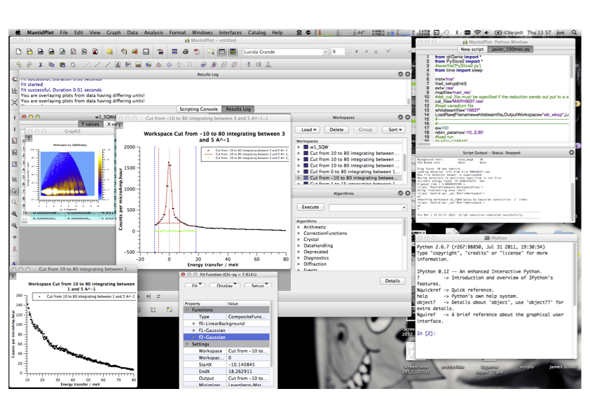

Slide 24
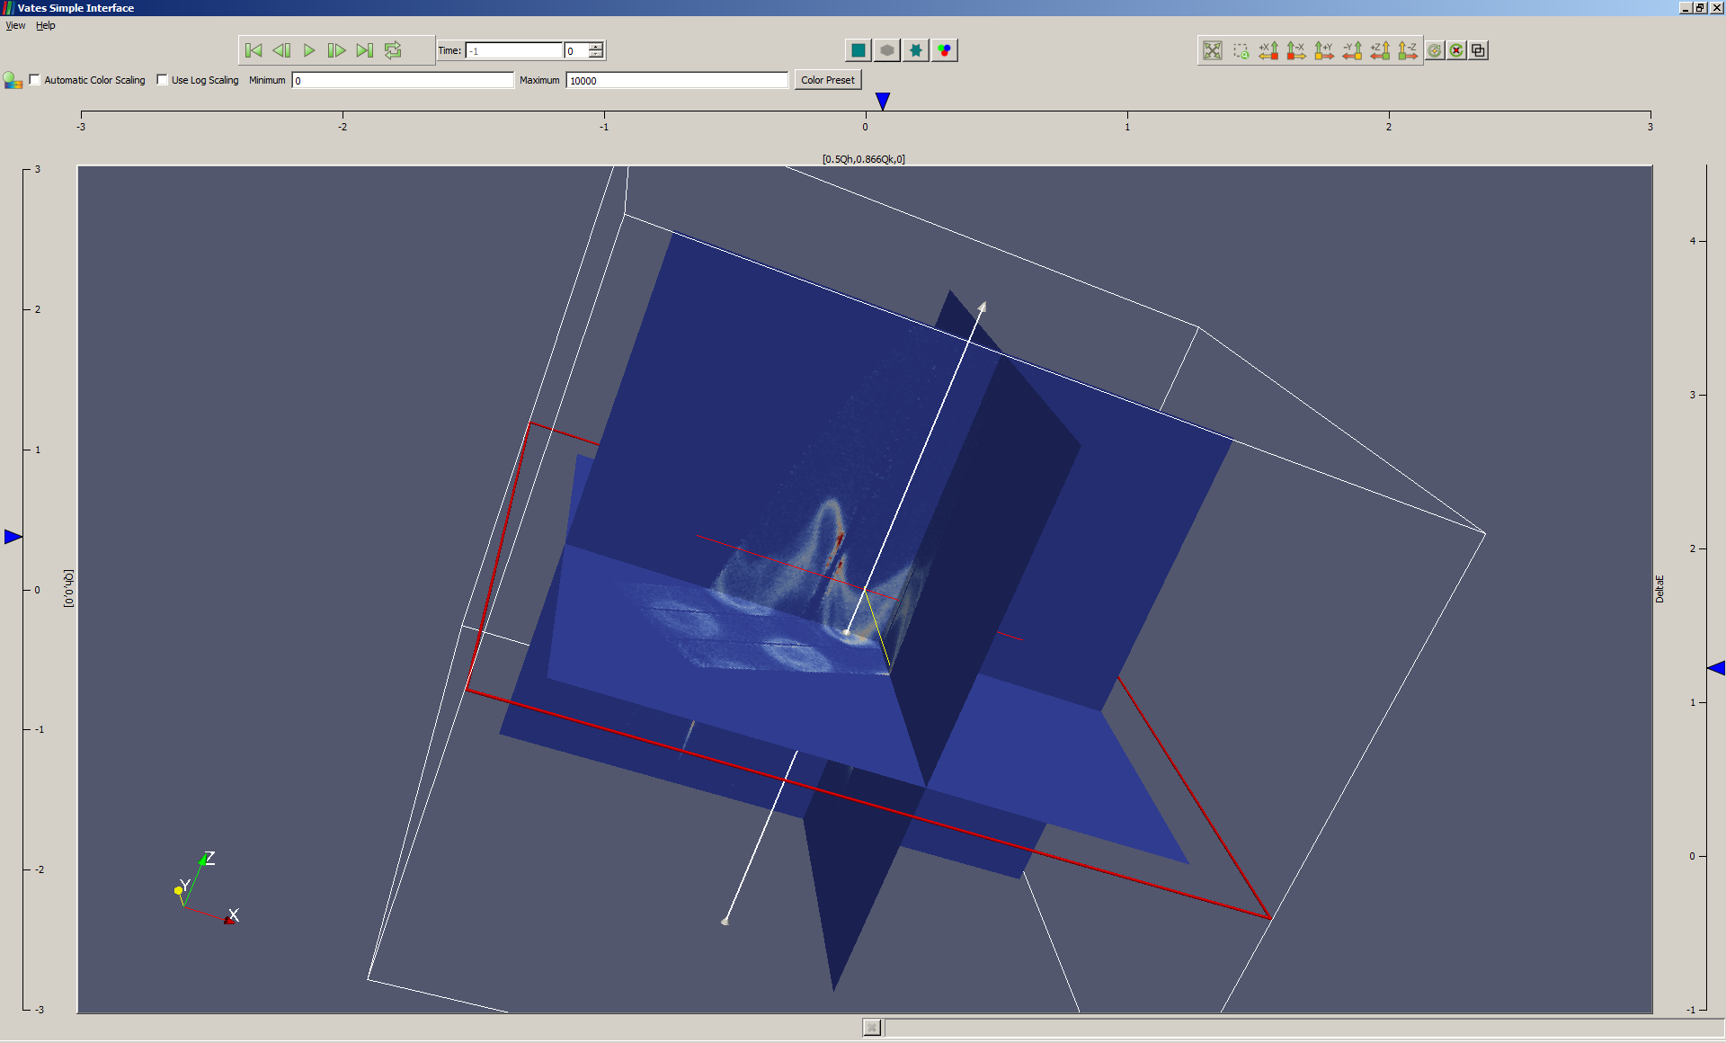
3D Visualisation : Make it easier
Notes:
Our first implementations of the visual rebinning, were plugins to a 3rd party visualisation framework called ParaView. We quickly discovered, that most users, did not need the full power of the ParaView framework, and that some common operations, such as slicing projections through the data, required too many mouse clicks and took too long.
So we prototyped building a stripped down GUI, using the native ParaView framework as a back-end. This worked quite well, so we ended up integrating it with our MantidPlot application. The simple GUI supports multiple view, this one allows users to generate n-orthognal slices. All they need to do is click on one of the outer axis, which generates one of these blue markers, they can then slide it up and down, and it will move and render the associated projection in real time.
“multislice view”

Slide 25
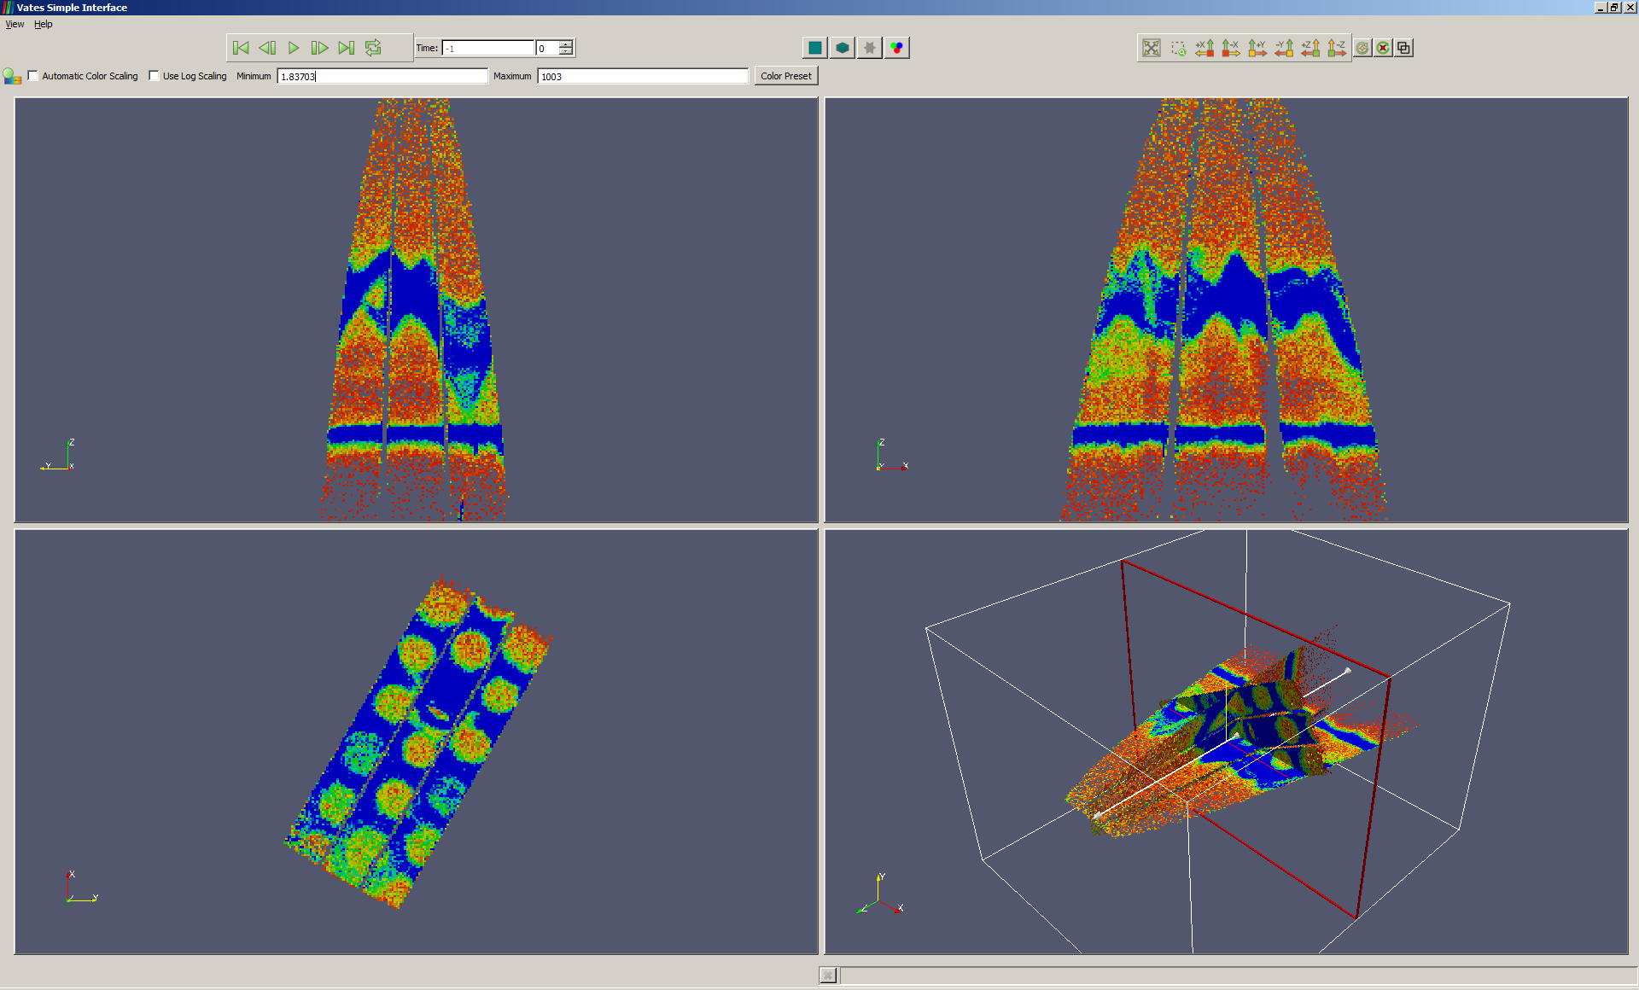
3D Visualisation : Make it easier
Notes:
Another view mode is the three slice mode, here users get a fixed number of projections, each in its own nested sub-window. From the 3D one on the bottom right, they can move the position of the slices, which will cause the corresponding projection to update. ”3-slice view”

